Slide 1
Cartoon Maker

Slide 2
Functions
Make a movie an animation
Cam (Later removed)
Make it a cartoon

Slide 3
I
Make a movie an animation

Slide 4
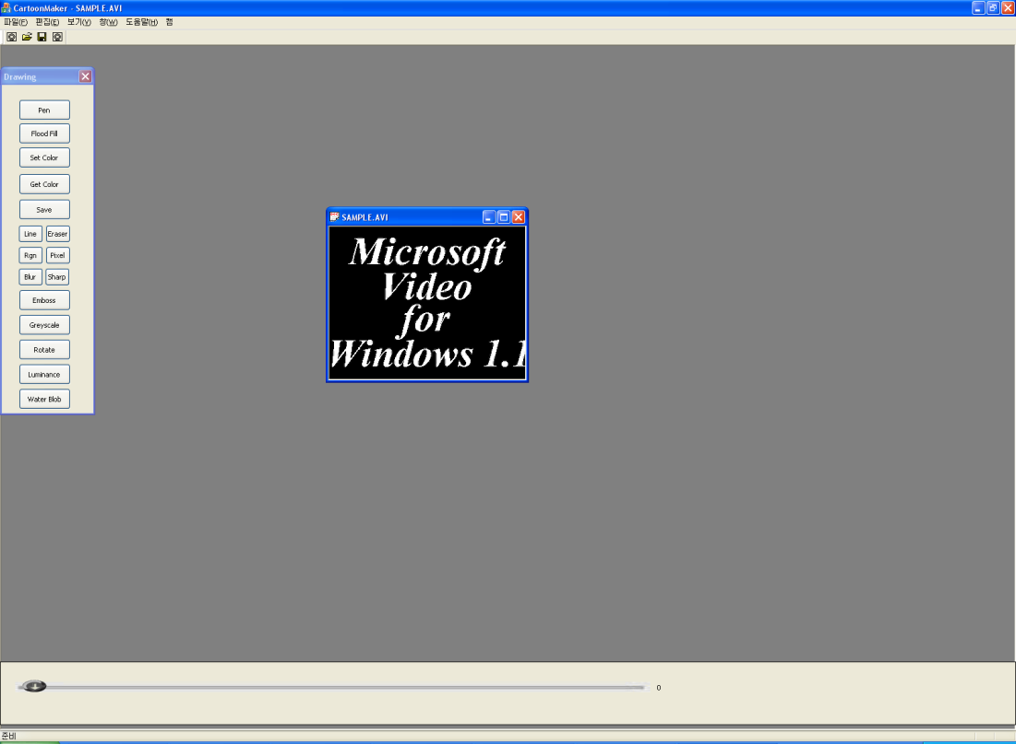
Make it a cartoon
User Scenario
Upload
Users can also load the previous files they worked on
Managed with XML codes
Uploaded Screen

Slide 5
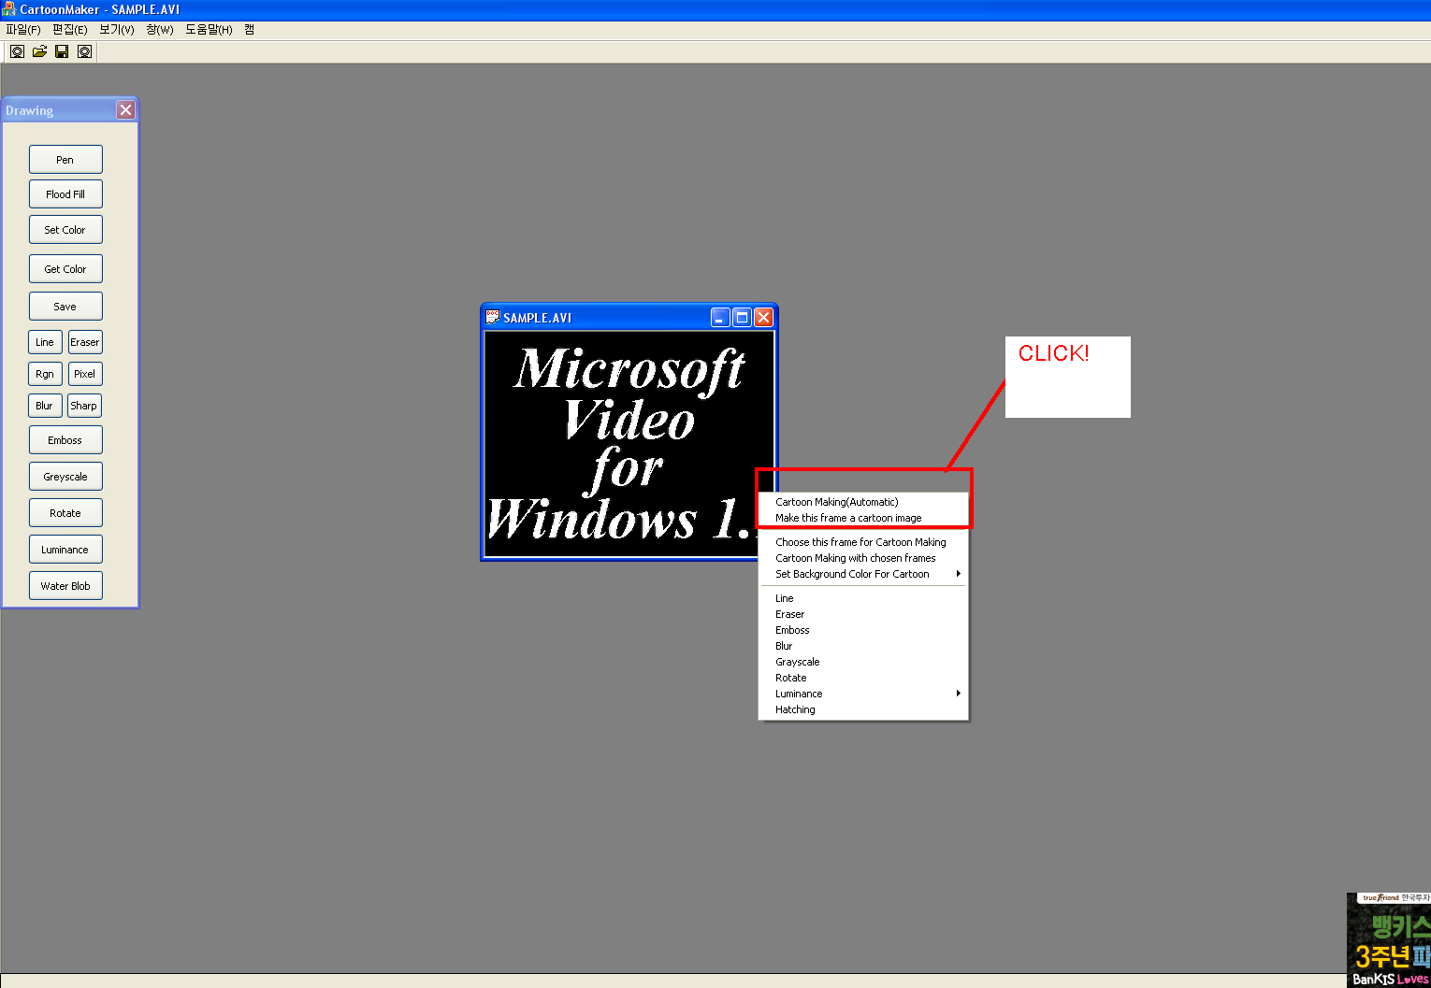
Make it a cartoon
I. Click on ‘Cartoon Making’ on the contest menu
OR
II. Users can make a desired frame a cartoon image by clicking on ‘Make this frame a cartoon image’ on the context menu

Slide 6
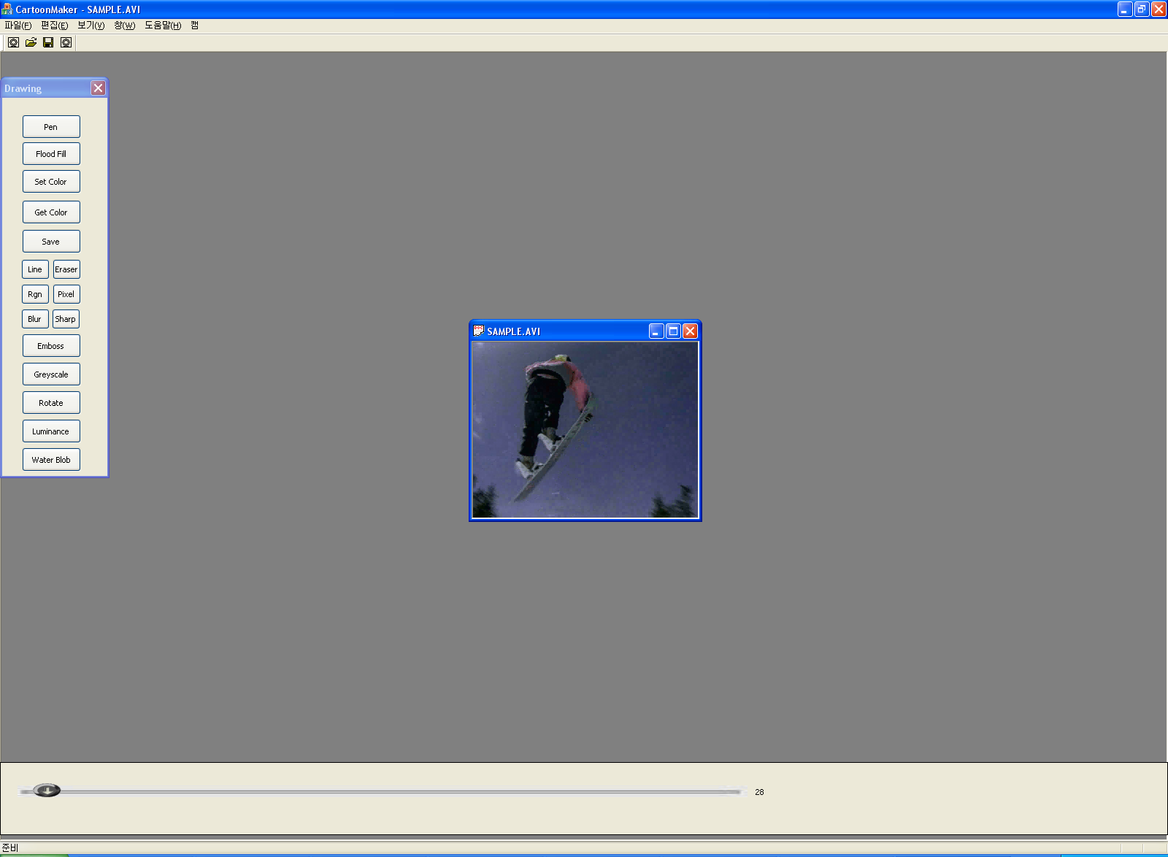
Make it a cartoon
Selected Image ➔

Slide 7

Make it a cartoon
Make it a cartoon image ➔

Slide 8
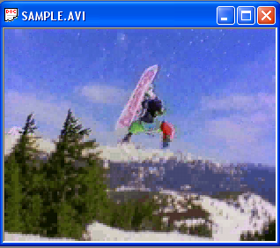
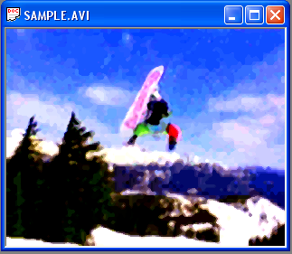
Example

Slide 9
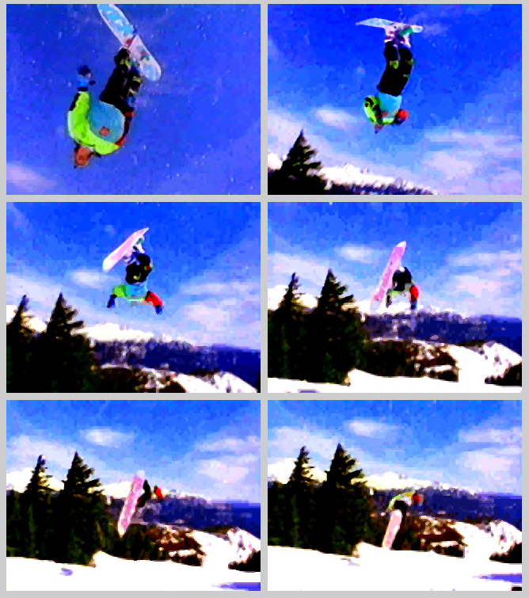
Users can make a comic book with the program
A Cartoon page made by users ➔

Slide 10

Original video

Slide 11

Converted Video

Slide 12
More
The software also offers another way to convert to a cartoon ➔
Steps
I. Edge detection
Succeeded
II. Hatching(Add Patterns)
Succeeded
Add colors
Manga Colorization Paper(Siggraph 2006)
Failed to implement

Slide 13
Thank you

